Slide 1
REST APIs
What, Why, How
Joshua Klein

Slide 2

What
REST stands for
REpresentational
State
Transfer
A REST API is defined by
A URL
An HTTP Verb
A Parameter Schema (optional)
A Response Schema (optional)
An Error Code Schema (optional)

Slide 3
What is a URL
Informally: a location on a network
Formally:
Universal
Resource
Locator
Example:
https://www.google.com

Slide 4
Why
Josh will now tell a story. Humor him or tell him to move on because this isn’t a history class.
Summary:
Many, many services available over the internet used to be stateful. This made it hard to relate a URL to the service accessed.
REST became the dominant solution to this problem for exposing well organized ways to access this data in a stateless fashion.
Notes:
In the bad old days of the consumer internet products (circa 1994-2008), URLs referred to locations, but software serving these URLs was often written to be stateful. Stateful means that the same action will have different outcomes depending upon what happened previously, and this state was sometimes communicated through complicated or obfuscated means (e.g. HTTP cookies, IP address sniffing). This meant that if you found a URL, it may not work properly if you don’t follow the same series of steps before each visit. Furthermore, it made it quite complicated to access such resources using a program that was not a web browser.
In order to make data access more consistent and practical outside of a web browser, the programs that serve these URLs needed to be made non-stateful, meaning all of the information they needed had to be encoded into the single HTTP request used to ask for data. The REST architecture arose out of a set of pragmatic decisions to make data access independent of “session state”, more intuitive to understand, and

Slide 5
Time for examples
GlyTouCan – Database of Glycan Structures
Uniprot – The Universal Protein Resource, the union of many great European biological databases
Entrez – The US National Center for Biotechnology and Information’s web service branch

Slide 6
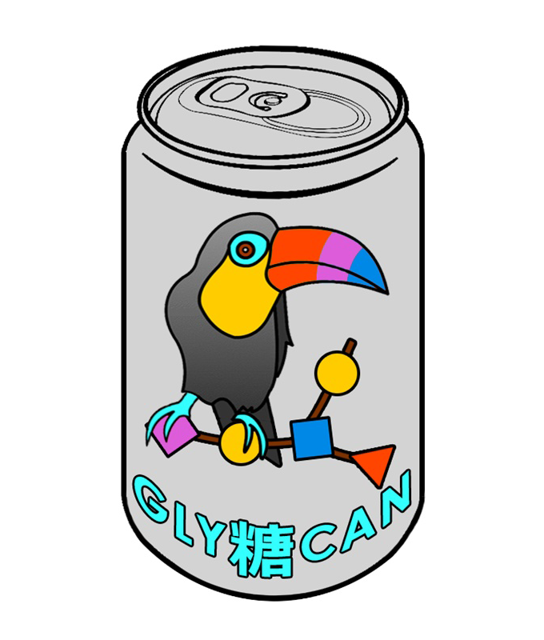
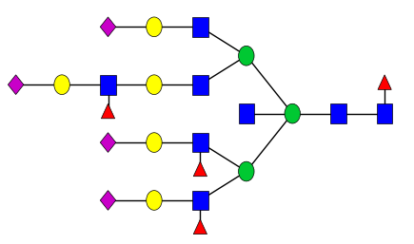
GlyTouCan
A database of glycan structures
Host: https://glytoucan.org/

Slide 7
Getting Started
GlyTouCan documents their REST routes with Swagger:
https://api.glytoucan.org/swagger-ui.html#/
Swagger even lets you try out API requests in the browser, so we’re going to play with that now.
Accession Number: G54701OK

Slide 8
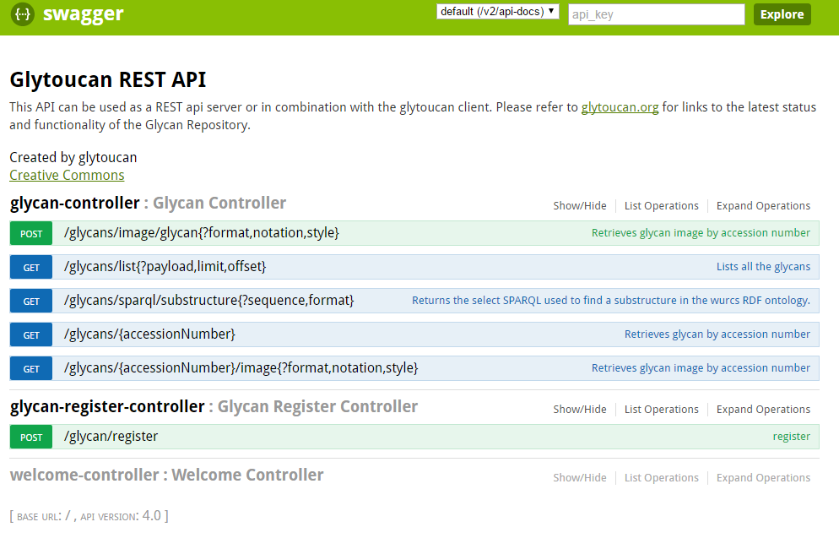

Slide 9
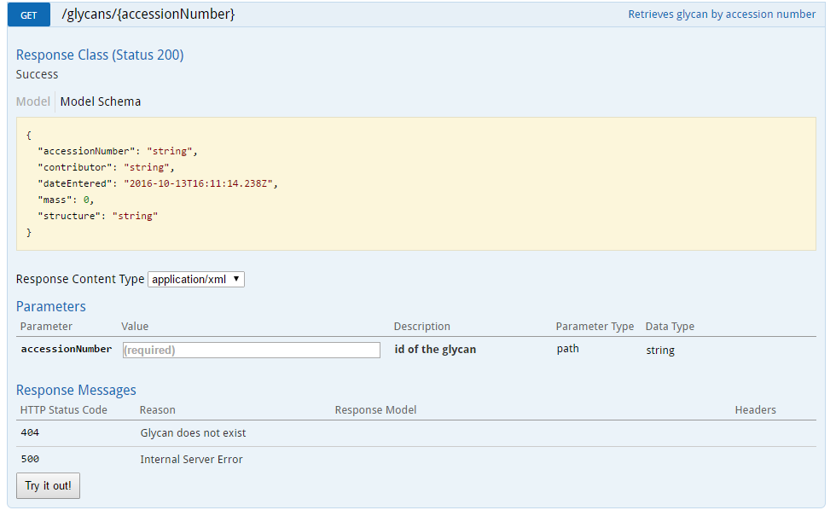
HTTP Verb
URL Path
Response Schema
Parameter
Schema
Error Code Definitions

Slide 10
Doing it programmatically
Best HTTP Client Library Ever Written
import requests
_get_glycan_base_url = "https://api.glytoucan.org/glycans/{accession}"
def get_glycan(accession, response_format='json'):
headers = {
"accept": "application/{response_format}".format(
response_format=response_format)
}
prepared_url = _get_glycan_base_url.format(accession=accession)
response = requests.get(prepared_url, headers=headers)
return response
Set up HTTP request metadata

Slide 11
Response Formats
This API serves one of two formats:
XML
The oldest, probably most widely used data exchange format
Almost looks human readable
Easy to create, wide support for most languages
Many ways to encode the same idea
JSON
A newer, popular format for data exchange
The lingua franca of browser-based information passing
Faster and cheaper than XML

Slide 12
More Data, More Routes
May even lead to multiple ways to do the same thing
Exposing extra information means adding another API endpoint

Slide 13


There Must Be A Better Way

